Slide 1
An Empirical Study of the Financial Costs of Internal Stakeholder Related Non-compliance Incidences within U.S. Companies
1
Business Analytics for Managers
——with Tableau

Slide 2
2
Problem Statement
Problem Statement: Is there a positive correlation between the number of employee-related non-compliance incidences and the incurred financial costs within U.S. companies?
Rationale:
Company executives often find themselves violate employee-related regulations because of many established laws and government regulations
Serious non-compliances lead companies to penalties and even dissolution
It is paramount to have a thorough understanding in regard of corporate compliance for companies to grow

Slide 3
3
Project Significance
Companies can utilize this project results as a benchmark and reference to avoid non-compliance incidences by:
Reviewing current internal control environment and remediate control activities as needed
Establishing new internal controls around employees-related rules and procedures
Identifying states that are more strict in terms of employee regulations
Regulators can gain industry/location/time-specific understandings of historical non-compliance issues to better pivot their future law reinforcement efforts (Maue, 2017)
Employees and job applicants are empowered with an insightful tool to wisely plan their career options based on company compliance history (Hendricks, 2017).

Slide 4
4
Summary of Hypotheses
The type of laws and regulations | is correlated with the financial cost (monetary penalties) of internal stakeholder non-compliance incidences within U.S. companies
The company’s geographical location
The company’s industry type
The time duration of case investigation
The time of the year

Slide 5
5
Summary of Variables
Independent Variables | Dependent Variables
Number of Violation found under Fair Labor Standards Act | Total Civil Monetary Penalties Assessment
Number of Violation found under Service Contract Act | Total employee involved in Violation
Number of Violation found under Family and Medical Leave Act | Total Back wages Agreed To Pay
Number of Violation found under Davis-Bacon and Related Act | Employee Agreed To Pay
Number of Violation found under Contract Work Hours and Safety Standards Act

Slide 6
6
Data Description
Data Size: 10 years × 9 variables × 156,777 rows =14,109,930
Data Types and Scale:
Type: Numeric, Integer
Scale: Nominal, Ratio
Number of years, Period: 10 years, from 2006 to 2015.
Data Source: Enigma Technology Inc.
Tools Selection: Tableau

Slide 7
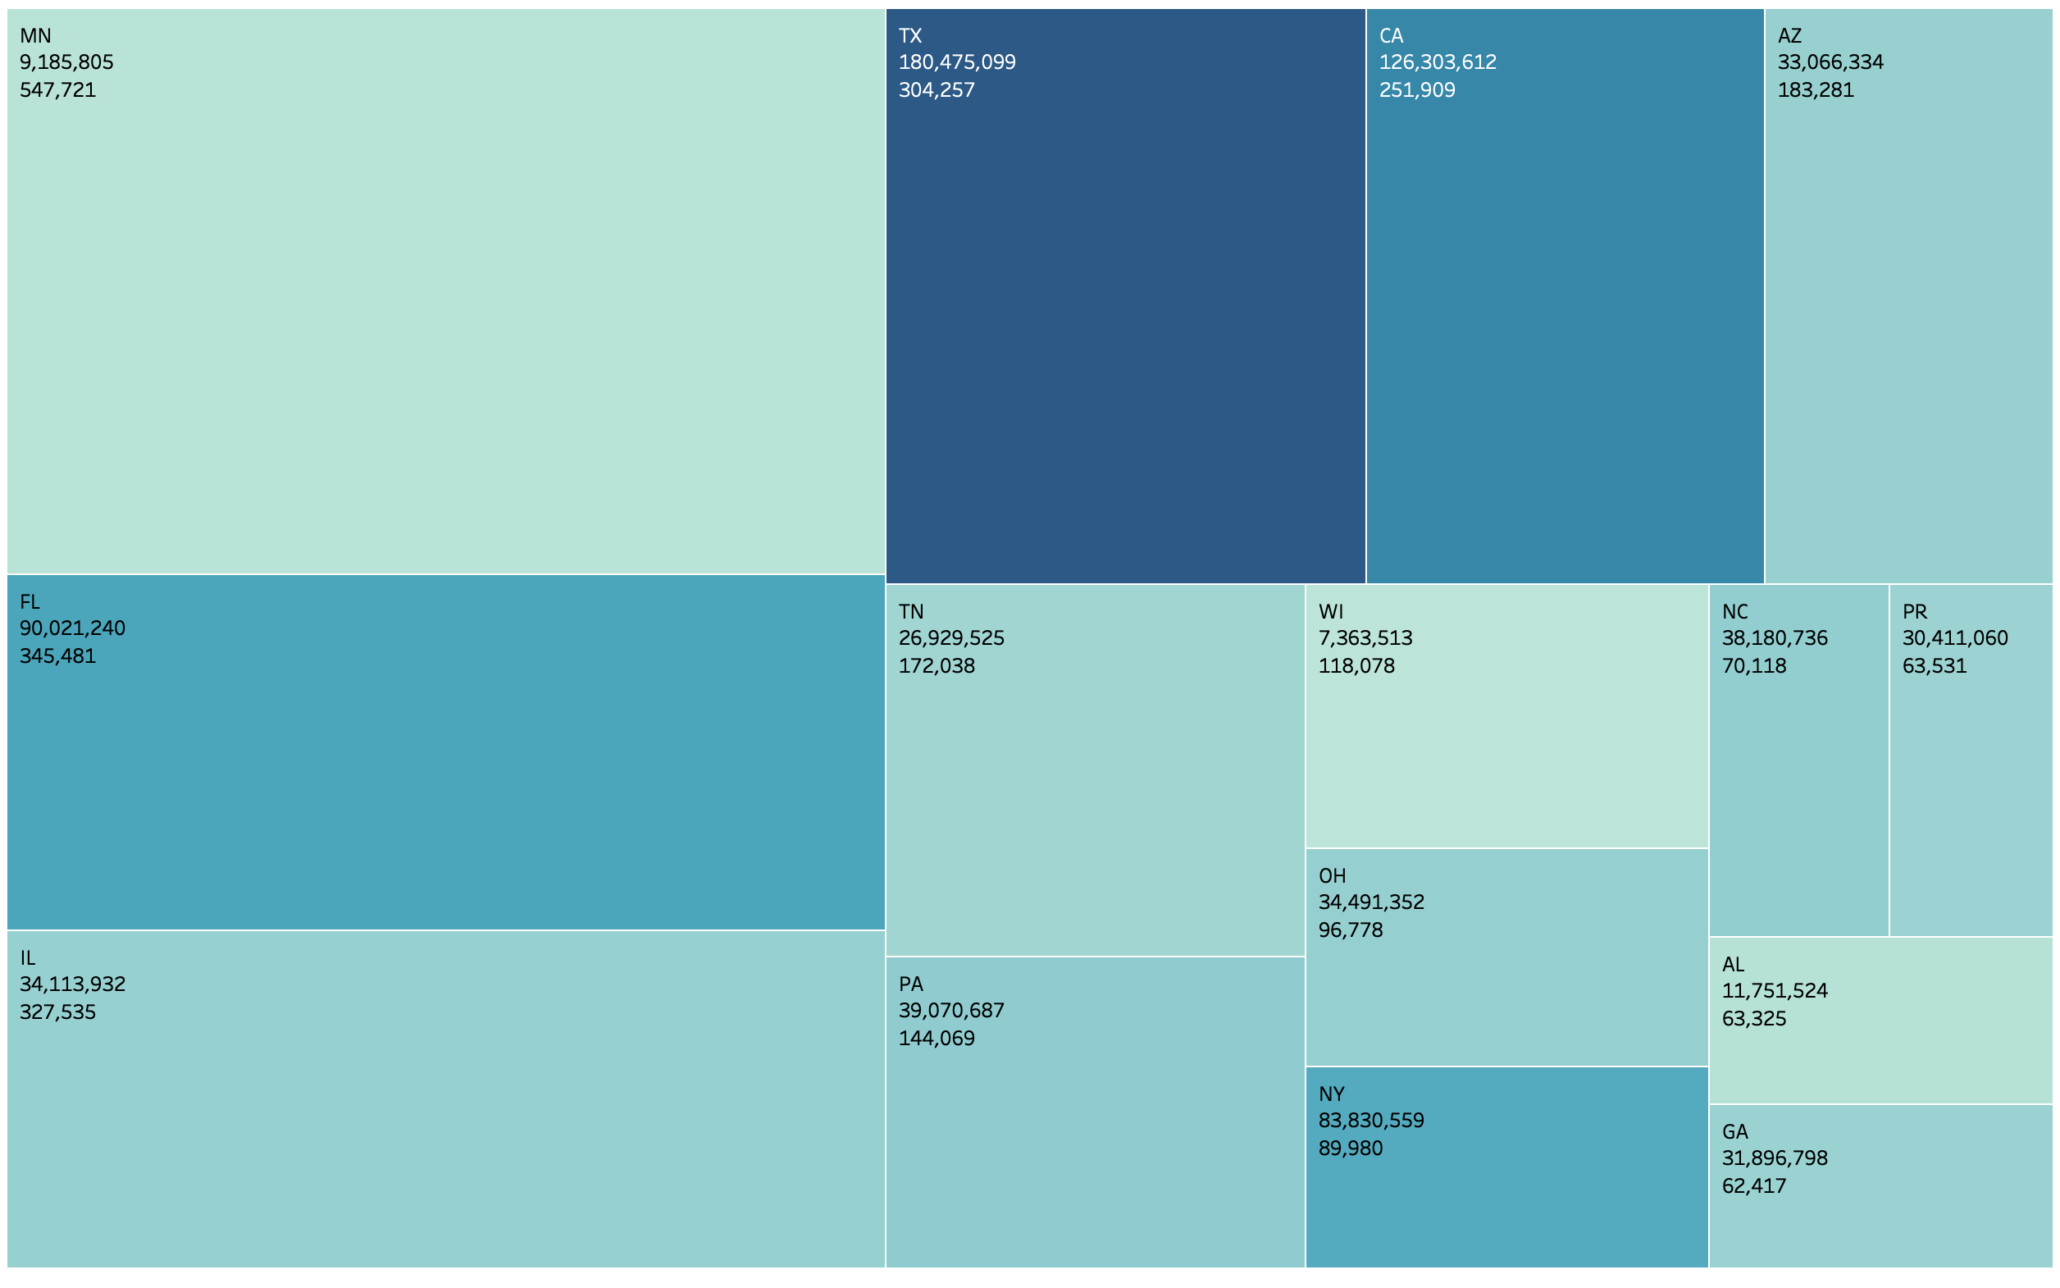
7
Descriptive Analytics 1 – State Summary
Description: The tree map shows the top 15 states that have the most employee related case violations and the monetary penalty incurred respectively. The size indicates the violation count while the color indicates the penalty amount.
Insights: Violations in Texas and New York cost the company more on average; California has a magnitude less than but comparable to Texas worth for further analysis.
Implications:
The cost of violations vary from state to state
Possible drill-down to city level on NY state to identify the most expensive infringements to help companies avoid such problems.
Figure 1. Tree Map of Total Monetary Violations Amount and and Case Violation Count Summarized by States
Notes:
CMP, Backwages, EE Agreed to pay

Slide 8
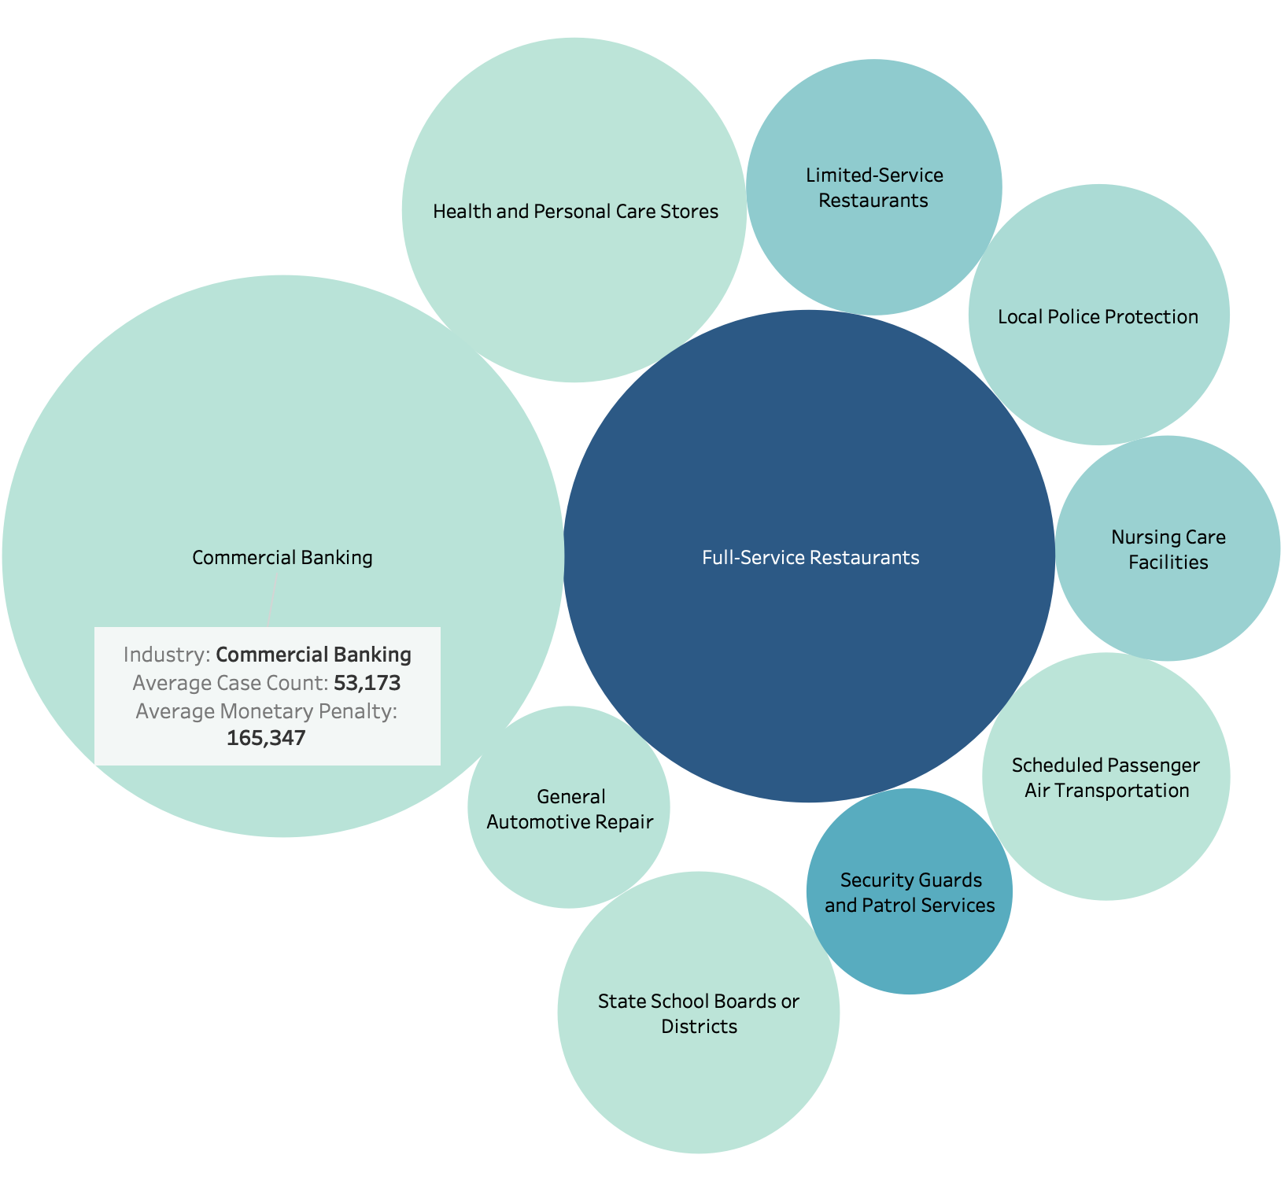
8
Descriptive Analytics 2 – Industry Summary
Description: The bubble charts shows the average number of case violation and average amount of monetary penalties for each industry (top 10 in terms of average number of case violation per year). The size indicates the number of violation cases and the color indicates the amount fined.
Insights: Commercial Banking industries has the highest case violations per year whereas full-service restaurant are fined more each year on average.
Implications:
Companies operating in such industries should carefully steer the business operations to avoid employee related non-compliance
Workers in these identified industries are required with more skillsets to stay in the green zone.
Figure 2. Bubble of Total Monetary Violations Amount and and Case Violation Count Summarized by Industry
Notes:
CMP, Backwages, EE Agreed to pay

Slide 9
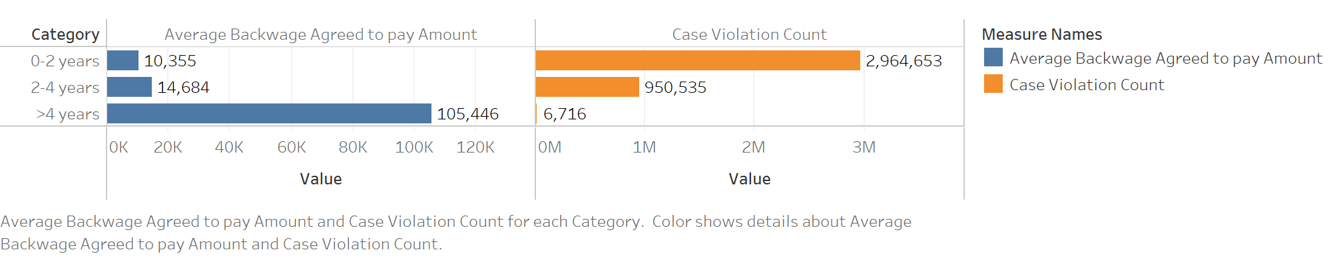
9
Descriptive Analytics 3 – Case Duration Summary
Figure 3. Bar Chart of Average Back wage agreed to pay and Case Violation Amount under different time durations
Description: The bar chart demonstrates the Average Monetary Penalty and Case Violation count under different time durations.
Insights:
In general, more cases are closed within 2 years of its opening date
As the time of the case investigation gets longer, the average monetary penalty for a single case will be much higher.
Implications:
The longer the case investigation is being conducted, the higher costs will be incurred for the company
When a violation case is found, enterprises should try to solve it in a shorter time in order to reduce the financial costs.
Notes:
CMP, Backwages, EE Agreed to pay

Slide 10
10
Descriptive Analytics 4 – Summary of Years
Description: Figure shows the monetary penalty amount and employee related violations count from 2006-2015.
Insights: From the chart we can see, maximum of penalty is in 2010 and the maximum of violation cases is in 2012.
Implications: Reason for the mismatching between penalty and the number of violations: regulations and laws take more time to get updated hence it cannot stay perfectly consistent with changes of employment and economical dynamics.
Figure 4. Bar Chart of Total Monetary Violations Amount and and Case Violation Count Summarized by Years
Notes:
CMP, Backwages, EE Agreed to pay

Slide 11
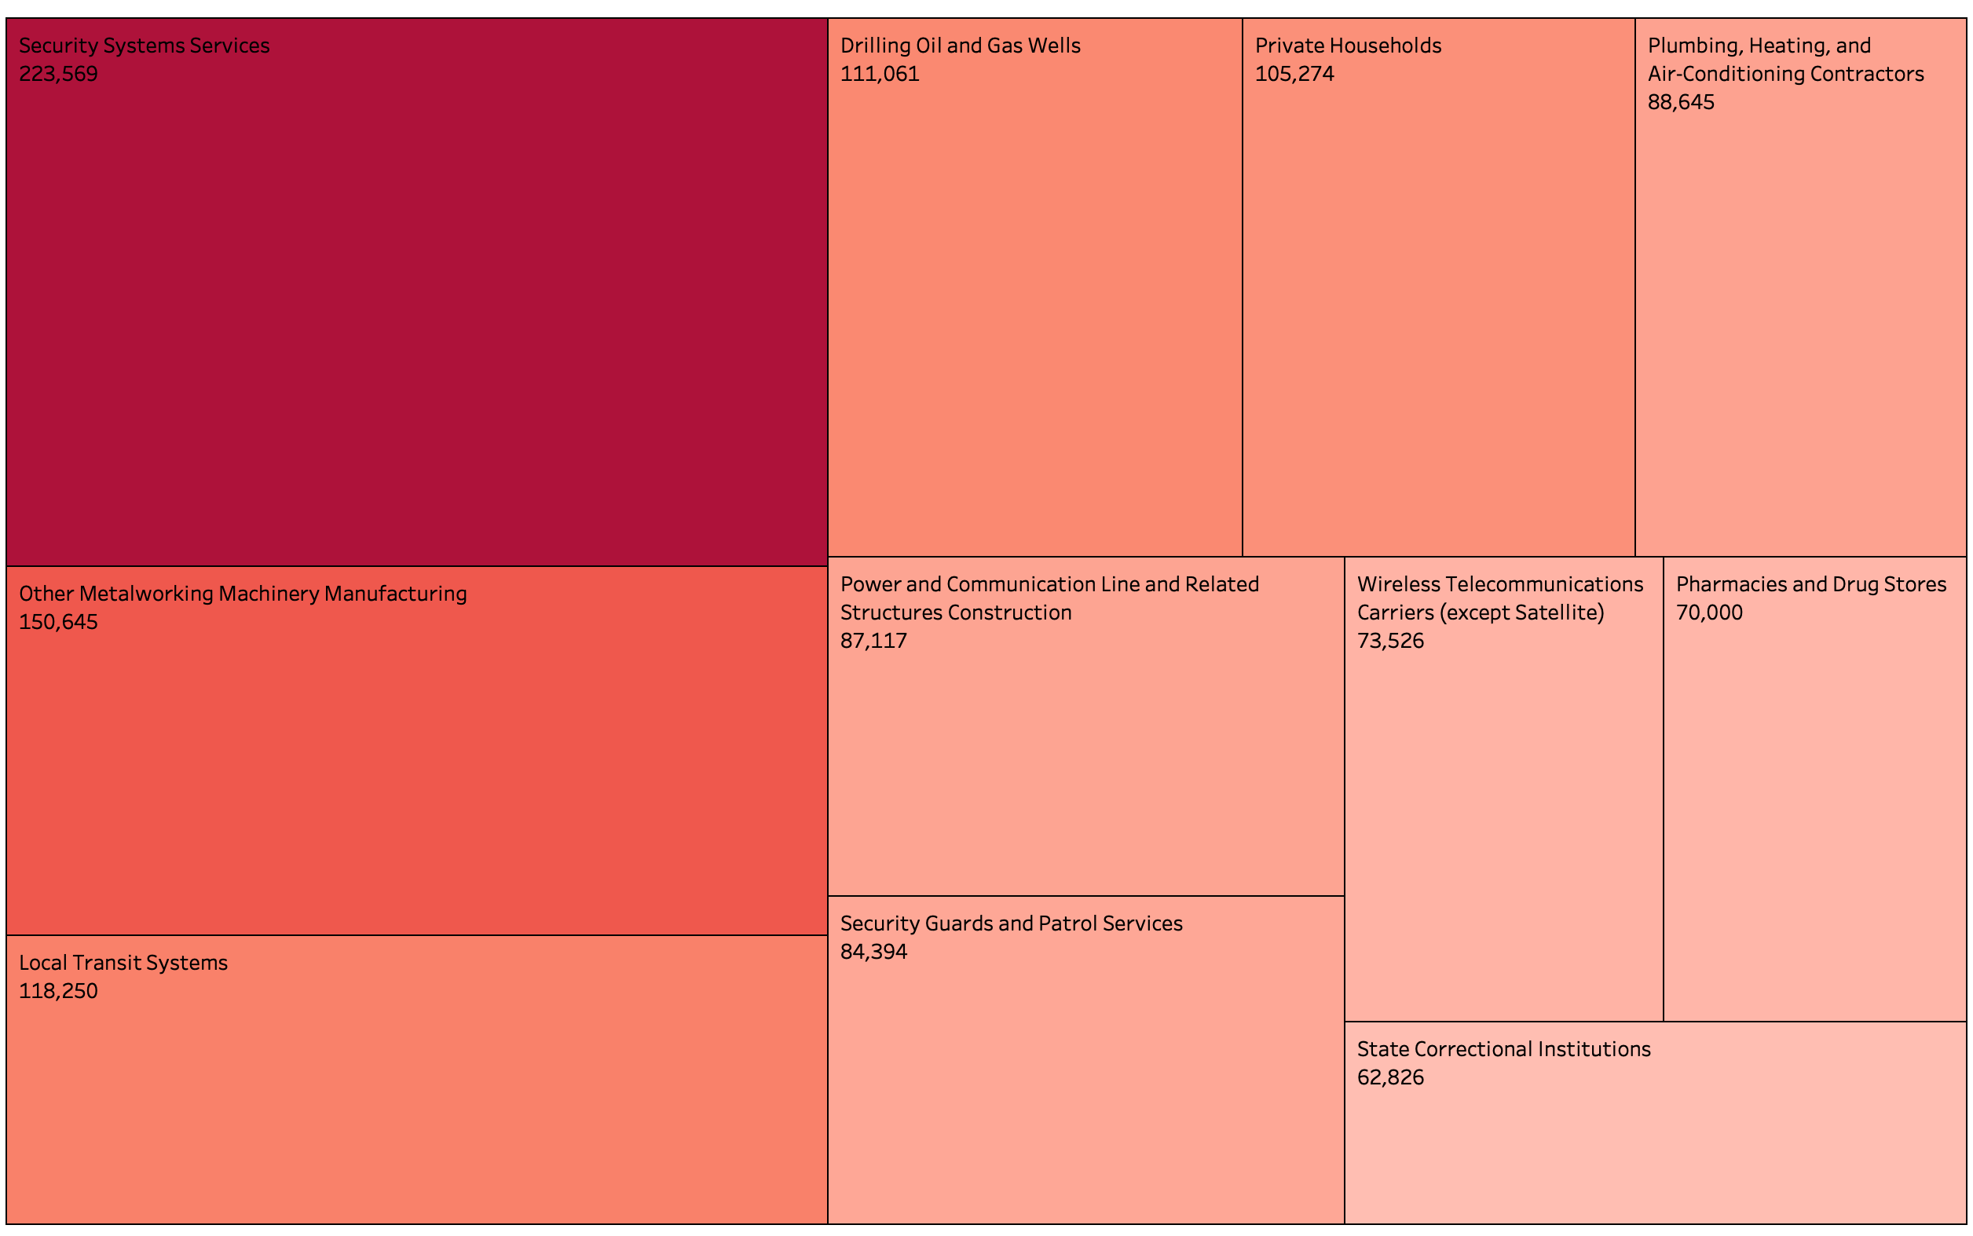
11
Descriptive Analytics 5 – Industry Summary
Description: The tree map shows top 11 industries that have the highest average monetary penalty per employee.
Insights: The size reflects the amount of average monetary penalty fined per employee, Security System Service, Metalworking Machinery Manufacturing and Local Transit Systems are the top 3 industry cost more when there’s laws violations
Implications: The financial impact of law violations is more significant on individuals in labor-intensive industries. Companies in these industries should establish more measures to protect the employees.
Figure 5. Tree Map of Monetary Violations Amount Per Employee Summarized by Industry
Notes:
CMP, Backwages, EE Agreed to pay

Slide 12
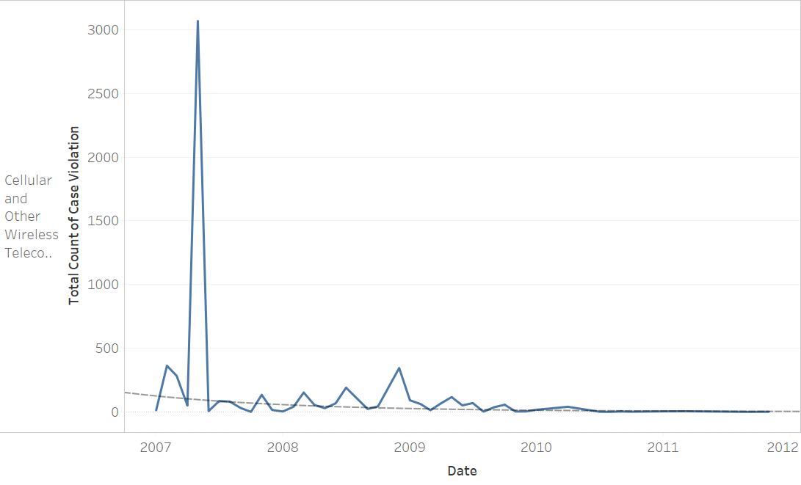
12
Descriptive Analytics 6 – Industry Drill-down
Description: This chart showcases the exponential trend line for total counts of case violation in telecommunication industries from 2007 to 2012.
Insights: According to the trendline, the case violation has been decreasing in telecommunication industries recently.
Implications: Active job seekers could utilize this information to optimize their industry preferences. Additionally, this trend could be used in a machine learning model to predict industry according to total case violations.
Figure 6. Trendline of Total Case Violations for Telecommunication Industry
Notes:
CMP, Backwages, EE Agreed to pay

Slide 13
13
Analytics – Statistical Model
Hypothesis: Is the time of the year when a case is opened positively correlated with the civil monetary punishment ?
Rationale:
Due to the change of laws and regulations over the years, the monetary amount for the same case violations may vary.
Knowing which years are associated with higher monetary penalties helps the company to study the macroeconomic environment and react agilely to changing regulatory dynamics
Analytic Type: Predictive
Notes:
CMP, Backwages, EE Agreed to pay

Slide 14
14
Analytics – Machine Learning Model
Hypothesis: Is it possible to forecast the case investigation durations based on the violation type, company industry and time of the year?
Rationale: Knowing how long it will take for a certain case to be closed helps the company to plan strategically beforehand
Analytic Type: Predictive
Notes:
CMP, Backwages, EE Agreed to pay

Slide 15
15
Conclusion
Employee related non-compliance incidences in Texas and New York cost the company more on average
Commercial Banking industry has the highest case violations per year whereas full-service restaurant are fined more each year on average.
As the time of the case investigation gets longer, the average monetary penalty for a single case will be much higher.
The financial impact of law violations is more significant on individuals in labor-intensive industries
The number of employee related non-compliance incidences has been decreasing in telecommunication industries recently.
Notes:
CMP, Backwages, EE Agreed to pay

Slide 16
16
Scope & Limitations
Type of Laws and Regulations: Our research only focuses on five employee-related laws and regulations based on the frequency of violations and relevance . The financial costs of unselected regulations are not captured in our research.
Time Coverage: Our research studies only non-compliance incidences during 2006-2015. Most recent incidences are not available in the dataset.
Notes:
CMP, Backwages, EE Agreed to pay

Slide 17
17
Policy/Managerial implications
Company
Identify “pain points” within company internal stakeholder management process to avoid future non-compliance issues
Identify states that are more flexible in employee related laws and regulations, may consider potential moving/outsourcing options
Employees: Understand employer’s compliance history to wisely plan career options
Regulator: Gain insights on the overall historical non-compliance incidences across the country to better strategize future law enforcement efforts
Notes:
CMP, Backwages, EE Agreed to pay

Slide 18
18
References
Hendricks, Drew (2017). The 3 Most Common Compliance Errors Every Company Makes. Retrieved from
https://www.inc.com/drew-hendricks/the-3-most-common-compliance-errors-every-company-makes.html
Maue, S., Carol (2017). The Top 10 Reasons for Fair Labor Standards Act Violations. Retrieved from
https://nydailyrecord.com/2017/08/28/legal-bytes-the-top-10-reasons-for-fair-labor-standards-act-violations/
Notes:
CMP, Backwages, EE Agreed to pay

